Slide 1
Free Fall and Influence of Air Resistance
Andrejs Cvečkovskis, Rauls Poļs, Jēkabs Priedītis

Slide 2
Aim of the Project
Accurately tracking the free fall of various objects by using image processing
Investigating the influence of air resistance on free fall
Evaluating the difference between the effect of air resistance on various objects
Assessing the suitability and limitations of video analysis for physical experiments

Slide 3
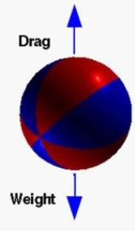



Theoretical Background: Modelling Free Fall
Drag coefficient b:
Terminal velocity VT:
Position of the object:
Notes:
y(t)=v^2/g*ln(cosh(gt/v_T))

Slide 4
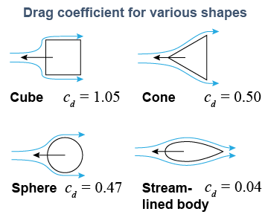
Theoretical Background: Shape Effects on Drag
Notes:
y(t)=v^2/g*ln(cosh(gt/v_T))

Slide 5
Experimental Setup
Five different objects dropped from a height of 2.5 meters
Uniform yellow background to improve contrast
Videos recorded at 4K resolution, 60 FPS
Each object dropped five times for statistical reliability

Slide 6
Sample Video

Slide 7
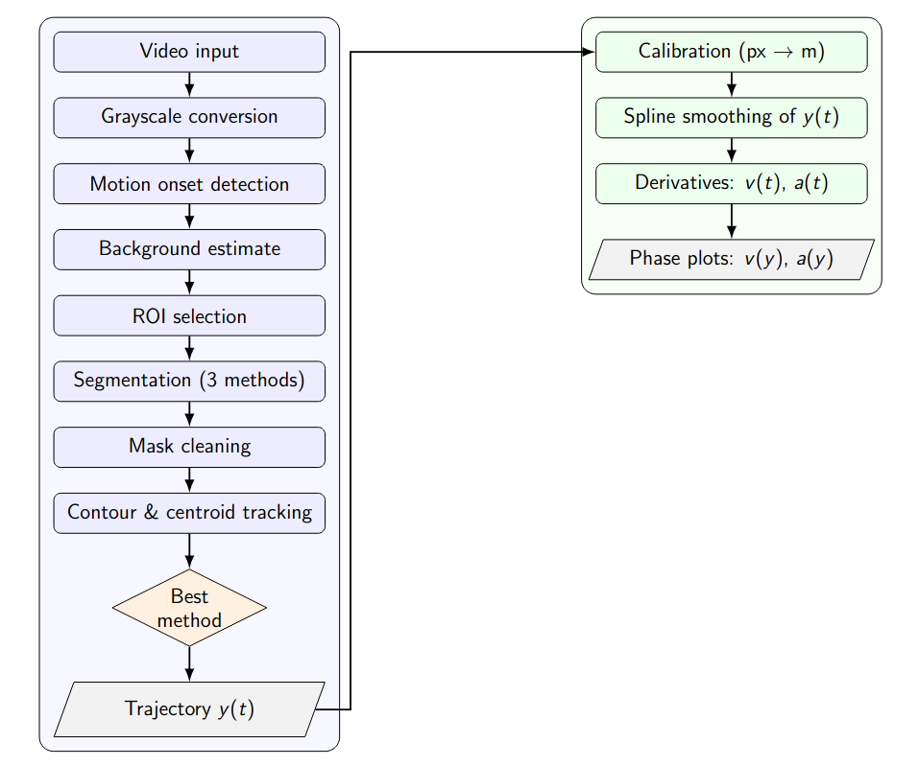
Image Processing

Slide 8
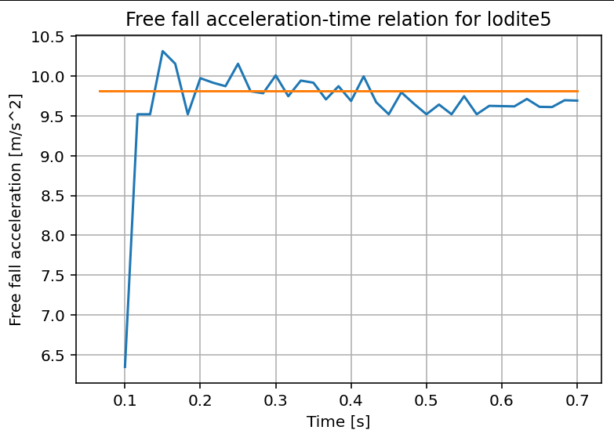
Results
g - time relationship for selected sphere measurement
Average g = [9.7 m/s² ]

Slide 9
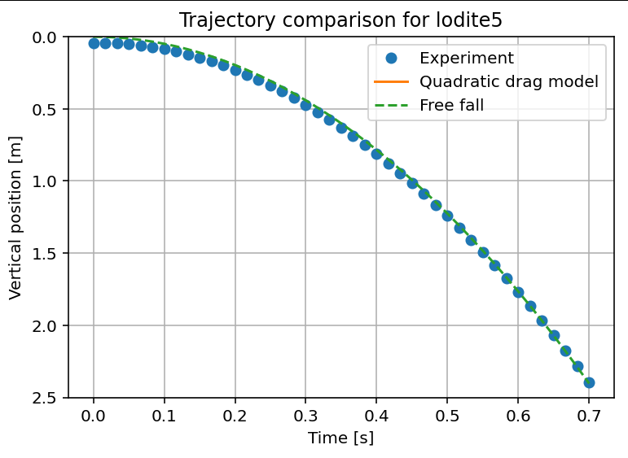
Results
Sphere

Slide 10
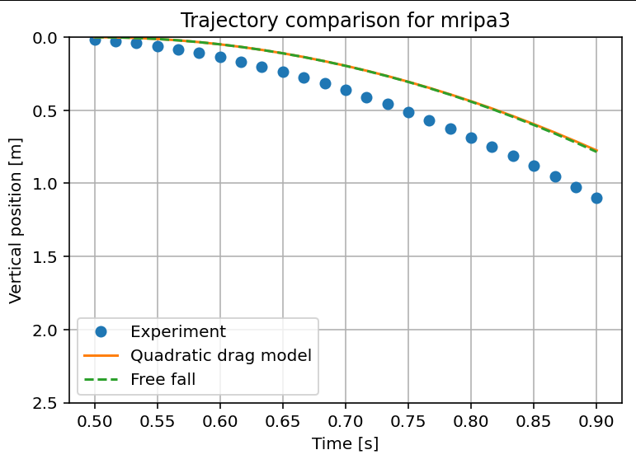
Results
Small disk

Slide 11
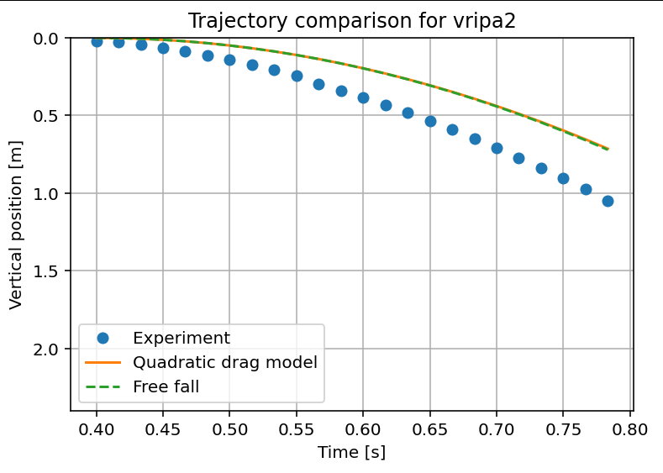
Results
Medium-sized disk

Slide 12
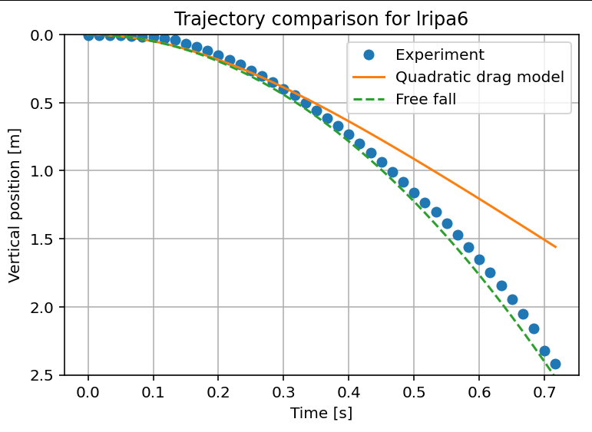
Results
Large disk

Slide 13
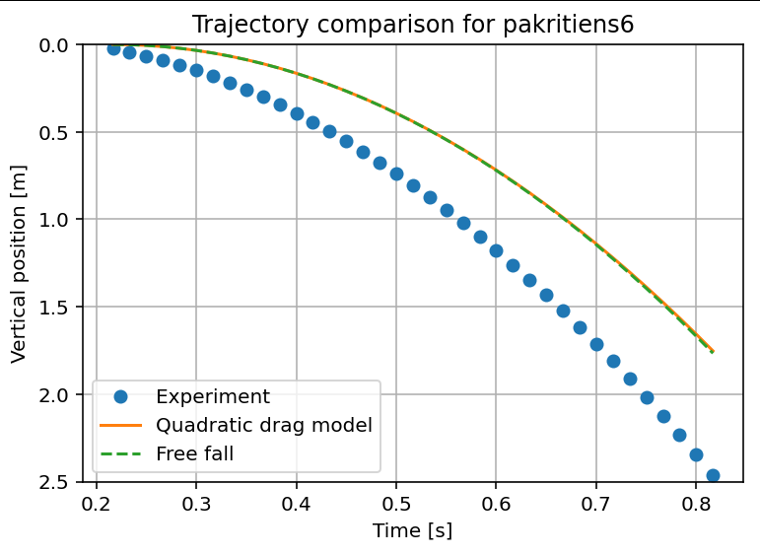
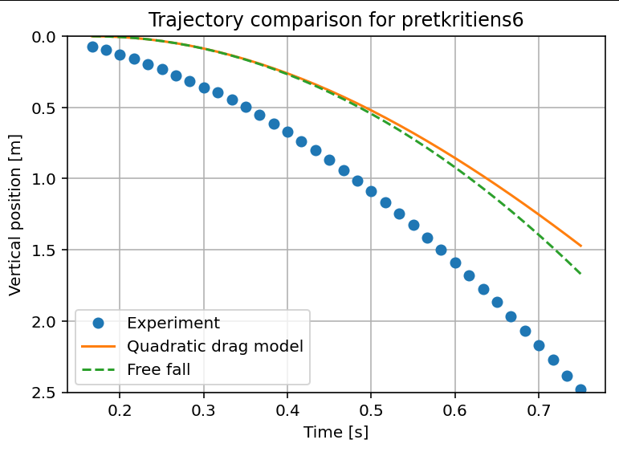
Results
Hemisphere (spherical side downwards vs. upwards)

Slide 14
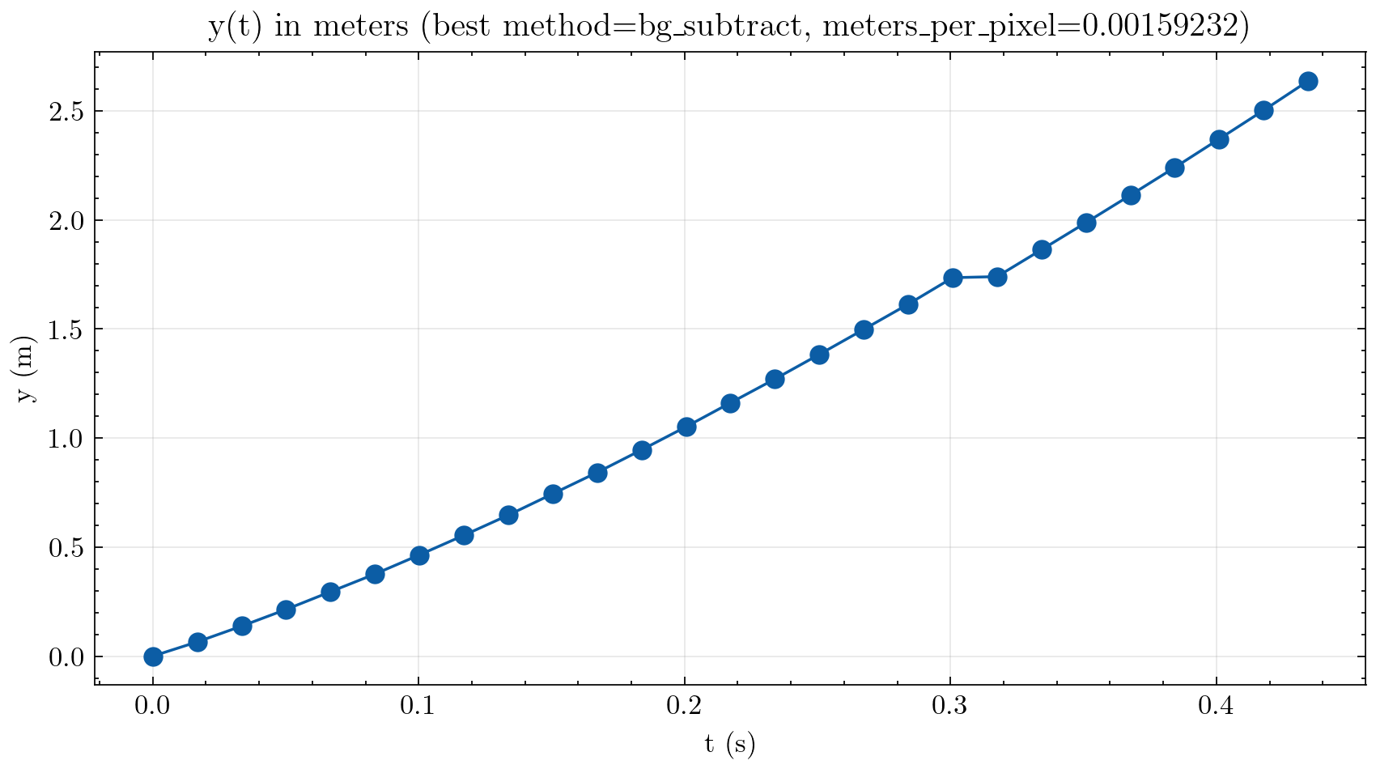
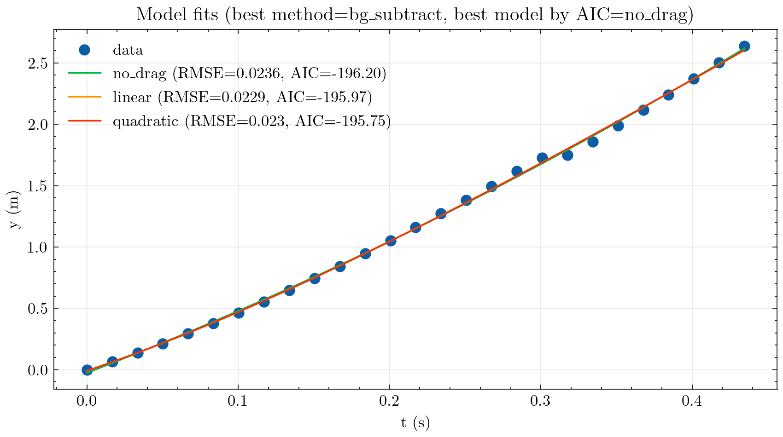
Results
Very light foam plastic ball

Slide 15
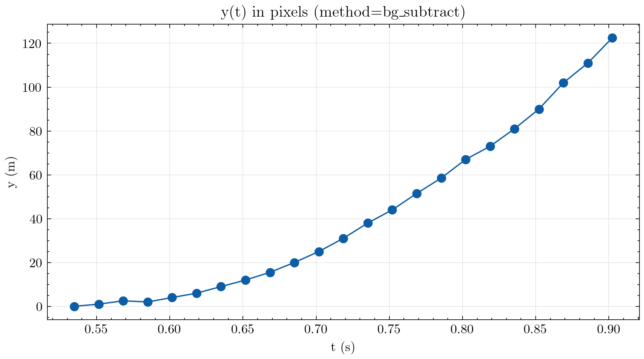
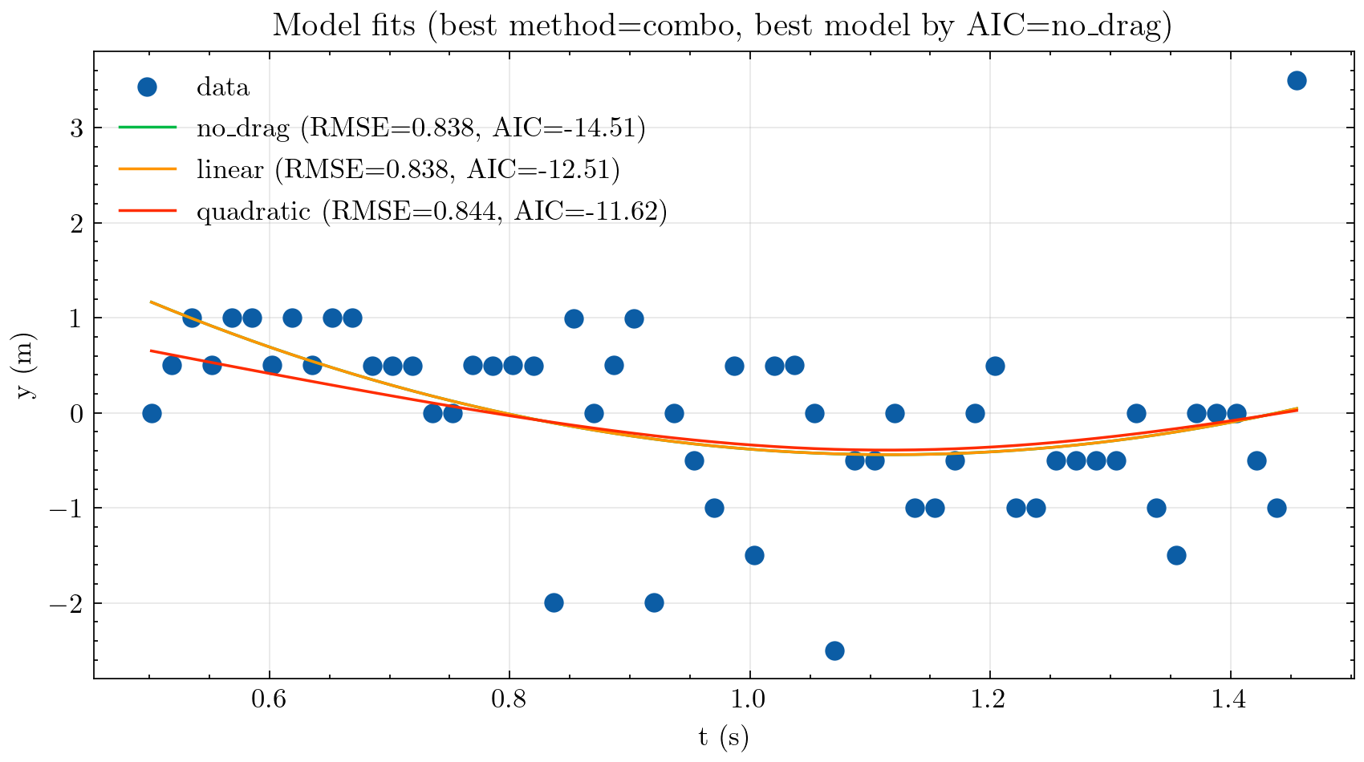
Results
Plastic bag

Slide 16
Conclusions
Differences in fall behavior reflect the influence of object geometry
Current methodology produces quantitative inaccuracies, but captures overall physical trends.
Limited frame rate and blurry video - primary sources of error
Despite limitations, video analysis mostly successfully captured non-ideal free fall

Slide 17
References
https://www.engineeringtoolbox.com/drag-coefficient-d_627.html
https://www1.grc.nasa.gov/beginners-guide-to-aeronautics/shape-effects-on-drag/
https://www1.grc.nasa.gov/beginners-guide-to-aeronautics/falling-object-with-air-resistance/
https://fsacta.weebly.com/drag.html

